Slide 1
Our Vision…
“Our vision is of an inspirational learning experience, enabling all our students to achieve individual excellence and grow as happy, independent and responsible young adults, before leaving us fully equipped to embark on exciting and fulfilling futures”
…excellenceineveryone

Slide 2
...excellenceineveryone

Slide 3
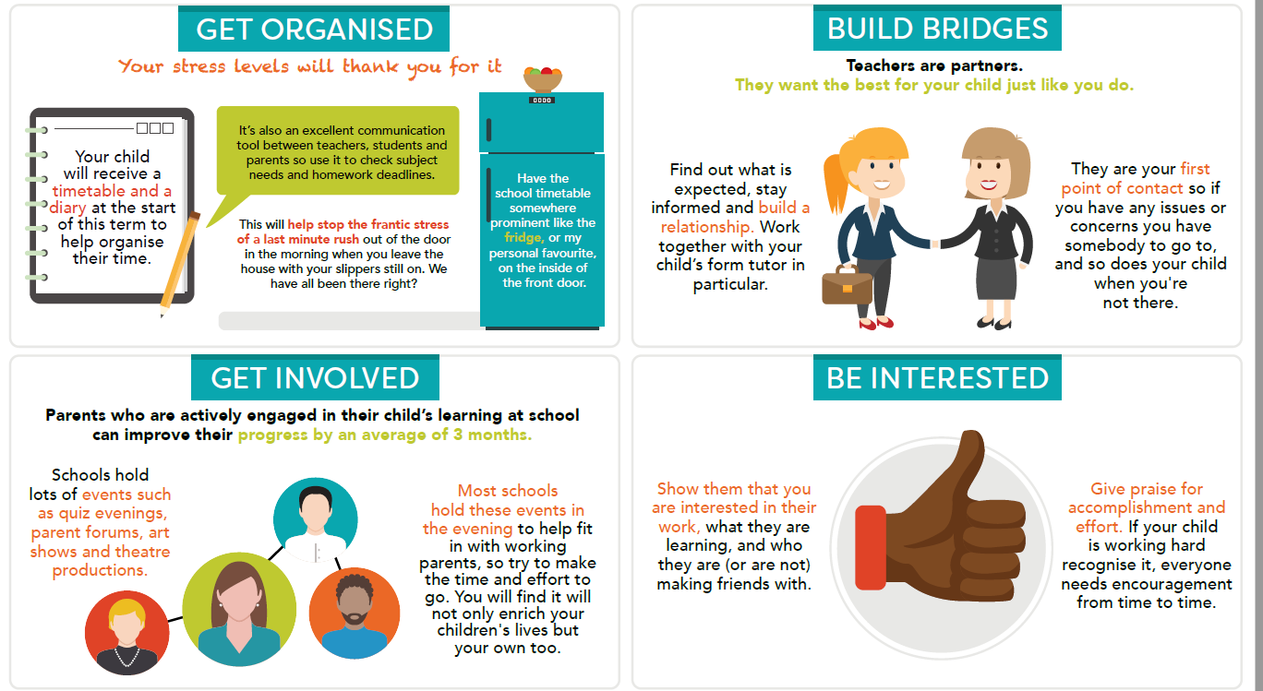
...excellenceineveryone

Slide 4
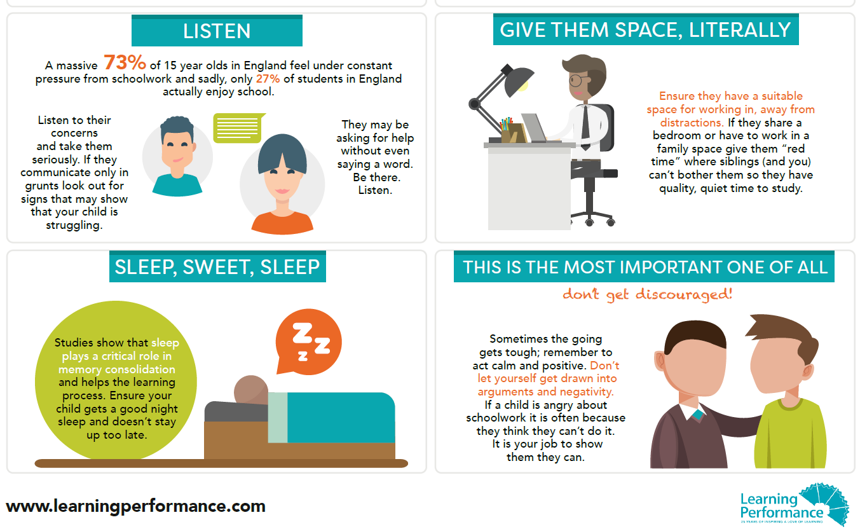
...excellenceineveryone

Slide 5
Year | Autumn 17 |  | Spring 18 |  | Summer 18
7 | 12/9 – Info Eve w/c 2/10 - A2L Report 5/10 – Meet FT | w/c 11/12 - Perf Report |  | w/c 26/2 – Perf Report 1/3 – Prog Eve | 9/5 – 16/5 – Assessment Window | w/c 16/7 – Full Report
8 | 12/9 – Info Eve | w/c 13/11 - Perf Report | 15/1 – 19/1 – Assessment Window 1/2 Curriculum Evening w/c 5/2 Perf Report 8/2 – Prog Eve |  |  | w/c 25/6 – Full Report
9 | 12/9 – Info Eve | w/c 6/11 - Perf Report 9/11 – Prog Eve | 1/2 Curriculum Evening | w/c 5/3 – Full Report | 1/5 – 4/5 –Assessment Window | w/c 11/6 – Perf Report
10 | 13/9 – Info Eve 25/9 – 6/10 – Assessment Window w/c 23/10- Perf Report | 7/12 – Prog Eve | w/c 22/1 - Perf Report | 12/3 – 21/3 – Assessment Window | w/c 7/5 – Full Report | 4/6 – 20/6 - Assessment Window w/c 9/7 Perf Report
11 | 13/9 – Info Eve w/c 2/10 - Perf Report 12/10 – Prog Eve | 20/11 – 29/11 – Assessment Window w/c 11/12 - Perf Report | w/c 29/1 – Full Report | 19/2 – 23/2 Assessment Window w/c 12/3 – Perf Report 19/3 onwards - FC | 16/4 – 20/4 – Possible Assessment Window
...excellenceineveryone

