Slide 1
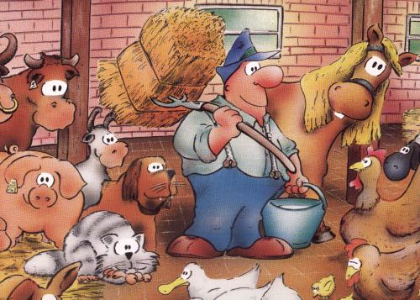
Functional Skills
Design a...
Farm
LO: Think about perimeter and area in context

Slide 2
LO: Think about perimeter and area in context
If you were to build your own farm, what would you need on it?

Slide 3
LO: Think about perimeter and area in context
Your task is to design a farm.
You will be given a sheet of A4 square paper. This will be your farm yard space.

Slide 4
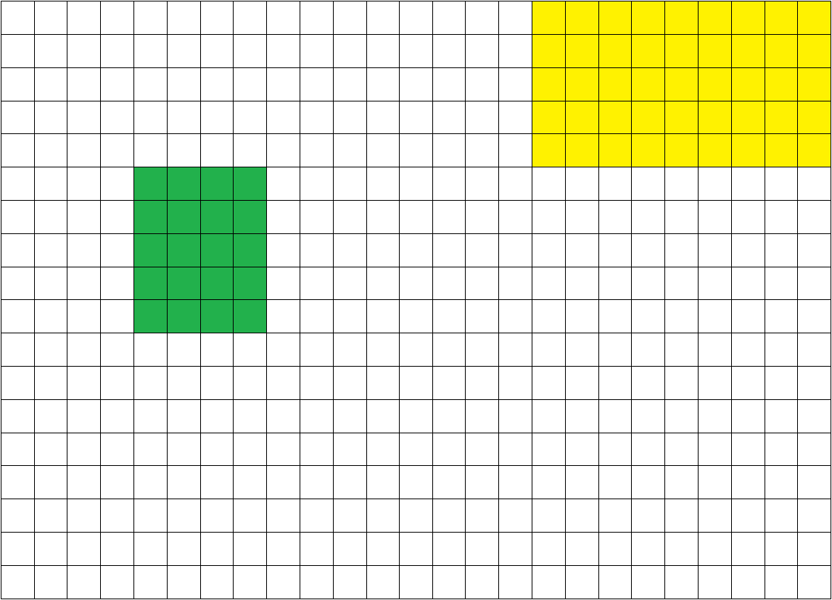
LO: Think about perimeter and area in context
Chickens
Peas
You will have to divide up the paper into the sections you want and add labels and a bit of colour.

Slide 5
LO: Think about perimeter and area in context
If you have animals then you will need to fence them in.
Chickens
Peas

Slide 6
LO: Think about perimeter and area in context
Chickens
Peas
You can assume there is already a fence around the farm.

Slide 7
LO: Think about perimeter and area in context
There is limit on the fencing you have available. You can only draw on 150 of the 1cm lines
Chickens
Peas

Slide 8
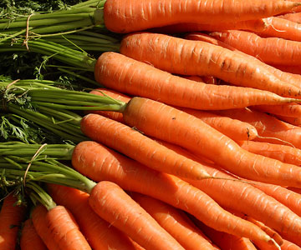
LO: Think about perimeter and area in context
Each square will have a value that it will add or take away from the farm depending on what you put on it.
For example, each square of carrots you grow will add £10 to your total value.
You want to maximise the total value of your farm.

Slide 9
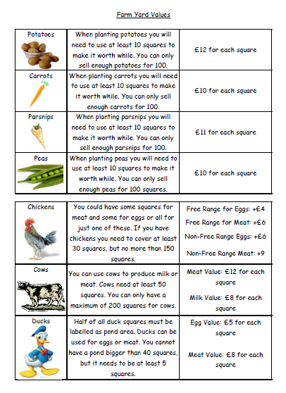
LO: Think about perimeter and area in context
You will be given this sheet that tells you how much value you get for each animal square or vegetable square etc.

Slide 10
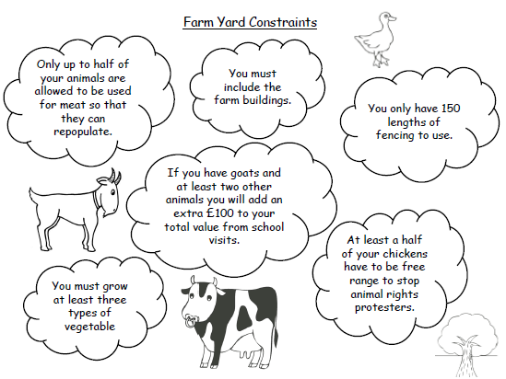
LO: Think about perimeter and area in context
You will be given a sheet with all the things you need to consider on it.
There are a few constraints when building a farm.
We will quickly go over a few of the main points.

Slide 11
LO: Think about perimeter and area in context
You must grow at least three types of vegetable.
At least a half of your chickens have to be free range to stop animal rights protesters.
You only have 150 lengths of fencing to use.
You must include the farm buildings.
If you have goats and at least two other animals you will add an extra £100 to your total value from school visits.
Only up to half of your animals are allowed to be used for meat so that they can repopulate.

Slide 12
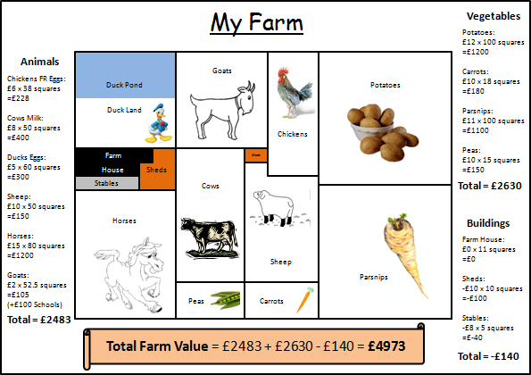
LO: Think about perimeter and area in context
Once you have designed your farm you need to glue it on to an A3 piece of paper.
Around the outside your should add details about your different farm areas.

